Slide 1

Telling the Story
Business Plan and Presentation
Global New Venture Challenge
2017
Waverly Deutsch

Slide 2
Agenda
Review GNVC Timeline
Business Plan: Key Elements
Presentation
Q&A

Slide 3
GNVC 2017 Timeline
October | November | December | January | February | March
10/24 – Feasibility summary due
11/4 – Class teams announced
Weeks of 11/28 and 12/5 – GNVC kickoff calls via WebEx with each team
12/5-7 Webinar – Business plans and presentations
12/10 – all GNVC teams must be finalized
12/20-23 – XP Update calls via WebEx
12/30 – XP First draft of plan due via email
1/5 – XP GNVC class begins
1/27 – XP Final business plans due
1/29 – XP Semi-final presentations
1/15-17 – AXP Update calls via WebEx
1/30 – AXP First draft of plan due via email
1/30-2/1 – EXP Update calls via WebEx
We are here
2/5 – AXP GNVC class begins
2/8 – AXP Final business plans due
2/10 – AXP Semi-final presentations
2/13 – EXP First draft of plan due via email
2/19 – EXP GNVC class begins
2/22 – EXP Final business plans due
2/24 – EXP Semi-final presentations
3/16 – GNVC Finals

Slide 4
Six Reasons to Write a Business Plan
A good business plan will help you:
Define and quantify the opportunity
Document your assumptions
Improve your business model
Figure out how much money you need
Share your vision
Force yourself to answer the hard questions

Slide 5
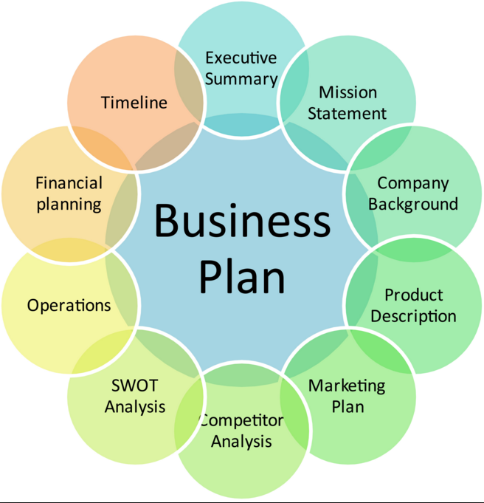







Elements of a Business Plan
Executive Summary
Financial Model
Company Background
Timeline and key risks
Problem
Operations
Solution
Team
Go-To-Market
Competitive Analysis

Slide 6

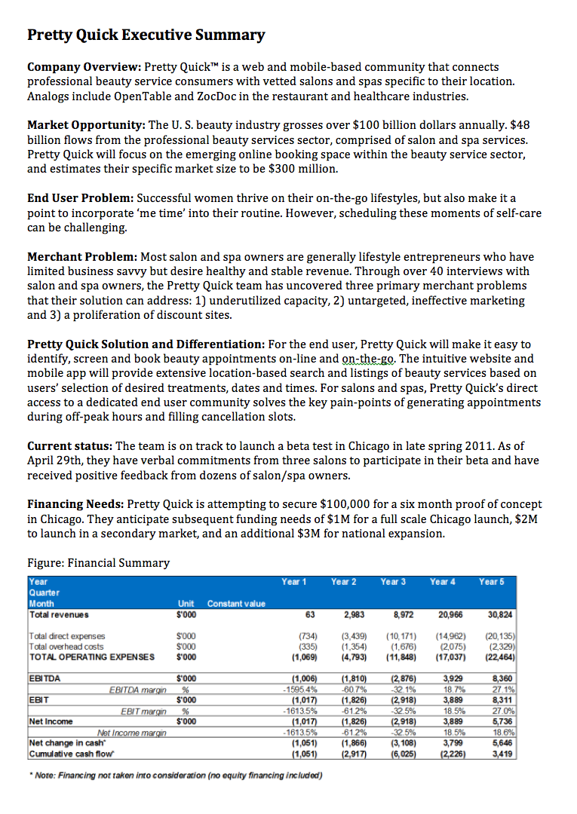
Executive Summary Company Overview Problem
  One page that clearly describes:
    The customer set
    Their problem
    Your unique solution
    The status of the company
    The potential – in numbers
    Your next steps
    Financing needed

Slide 7

Company Overview Problem Solution Go-To-Market
  Summary of business
    Mission
  Company details
    When founded
    Where founded
    Company structure

Slide 8

Problem Solution Go-To-Market Plan Competitor Analysis
  Who is the customer?
    Profile details
    Buyer vs User?
  What is the pain/opportunity?
    Description
    Quantifiable?
    Data from customer interviews
  How many people have this problem?
    Market size
    Initial target market

Slide 9

Solution Go-To-Market Competitive Analysis Team
  Detailed description of your offering
    Product? Service? Platform?
    Customer use case
    Demo – screen shots, prototype
    IP
  Differentiation

Slide 10

Go-To-Market Competitive Analysis Team Operations
  Marketing
    Message
    Key tactics
  Sales
    Accessing the decision maker
    Buying cycle
    Channels
  Customer Acquisition Costs

Slide 11
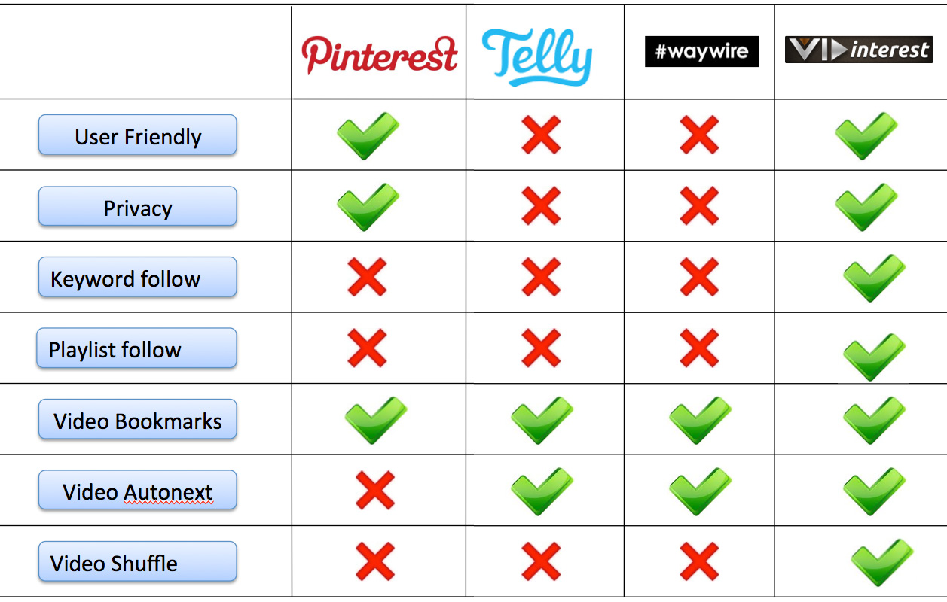
Competitive Analysis Team Operations Timeline and key
  Current competitors
    Direct and substitutes
    Strengths and Weaknesses
    Key differentiation
  Future potential competitors

Slide 12

Team Operations Timeline and key risks Financial Model
  Team bios
    Role in this company – avoid over titling
    Relevant experience – industry, role, entrepreneurial
    Credibility building titles and companies
    Tie to this business
  Advisors
  Critical gaps and plan to fill

Slide 13

Operations Timeline and key risks Financial Model
  Key Processes
    Production or service delivery – show the workflow
  Partners and suppliers
  Costs
    Startup
    COGS

Slide 14
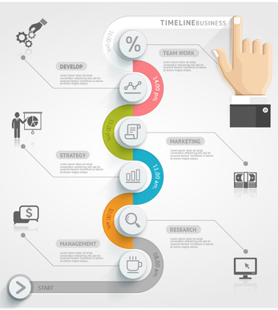
Timeline and key risks Financial Model
  Current status
    Product development
      Prototyping
      MVP
    Customer validation
    Partnership agreements
  Next 18 months
    Milestones
  Key risks
    Specific to your business
    Plan to address

Slide 15

Financial Model
  Start with your assumptions
    Price / average contract size
    Cost of customer acquisition
    Cost basis
    Contribution
    Lifetime customer value
  Show monthly cash flow for 18 months
  Show annual projections for 5 years
  You can summarize in document and include details in appendix
  Include research that supports assumptions – supplier pricing, competitor pricing, analog scaling process, etc.
  DO NOT SAY (OR BE) CONSERVATIVE!
  End with an ASK!

Slide 16
Formatting Requirements
Single PDF file
Cover page
Ten pages of text maximum
Single spaced
11 point font
Appendix: additional ten pages maximum
  Resumes / detailed bios
  Full financial model
  Analogs and other secondary research
  Customer research
Separate PDF – One page executive summary

Slide 17
First Round Presentation
Content:
Tell an interesting story
NOT a verbal summary of your business plan
NOT a product pitch
Make it concrete and real – screen shots, customer data, supplier names, business partner LOI, etc.
Goal: intrigue an investor, make them want to know more
12 minutes of presentation, 13 minutes of Q&A and feedback
All student members of team may present
  Outside team members may be involved in Q&A
PowerPoint not to exceed 20 slides
Format:

Slide 18
Remember, Winning an Investor is a Dating Process
Elevator Pitch
Business Plan Presentation
One Hour Meeting
Due Diligence
Term Sheet
Contract / Investment
Pick Up Line
Coffee Date
Dinner Date
Courtship
Engagement Ring
Marriage

Slide 19
Q&A

