Slide 1
Feasibility
Summary
Workshop

Slide 2
Agenda
Review CNVC Timeline
Feasibility Summary: Key Elements
Do’s and Don’ts
Q&A

Slide 3
Upcoming Events and Deadlines
^{Mission Driven Ventures}
Nov. 15 | 12-1 p.m. | Ida Noyes West Lounge
^{Customer Discovery}
Nov. 16 | 12-1 p.m. | Ida Noyes West Lounge
Feasibility Summary Deadline: Nov. 27 | 10 a.m.
^{Notified of Acceptance by} ^{Nov. 29}
CNVC Team Pitches and Networking
Nov. 30 | 4:30-6 p.m. | Harper Center 219

Slide 4
Key Elements of a Feasibility Summary
Value Proposition
Customer Segments
Competition
Intellectual Property
Customer Engagement
Revenue Model
Operations
Management Team
Progress to Date
Business Risks
Business Analogues

Slide 5
Value Proposition
What are you building and for whom?
Am I solving a customer’s need or problem?
Example 1
Example 2
The company has developed the SalivaSac™, a proprietary semi-permeable membrane that enables the collection in saliva of biochemical markers below 12 kilodaltons. The company will focus on finding those applications which meet this criteria and where there is an advantage to collecting a non-invasive sample.
The company’s objective is to develop non-invasive medical diagnostic tests. The first application is for using a proprietary saliva collection device to measure glucose levels in diabetics.

Slide 6
Customer Segments
Who are your customers?
Who are the different groups of people or organizations you aim to reach and serve?
How do you define your market?
What is the potential market size?

Slide 7
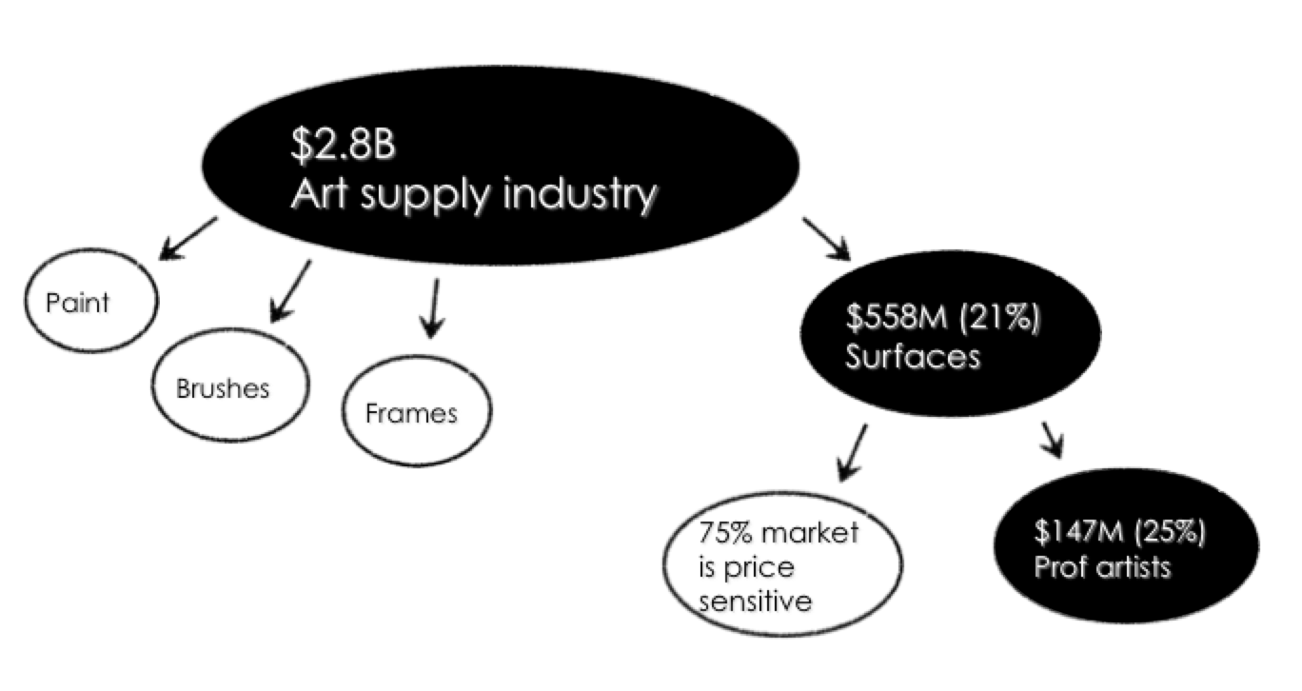
Customer Segments
Market Size Estimate

Slide 8
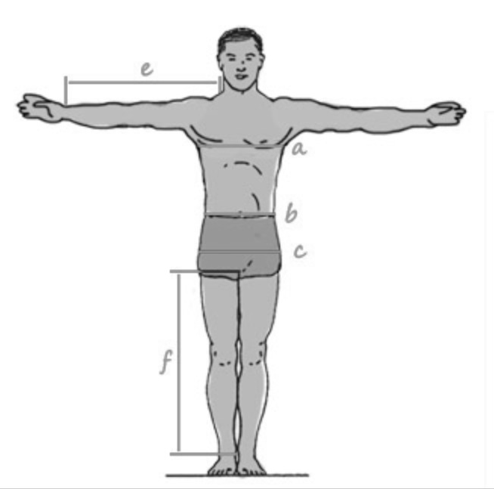
Customer Segments
Customer Profile
29 years old
Single
City dweller
$60-80K Income

Slide 9
Competition
How will you win?
Who are current players in the market?
Who could be your competition in the future?
What are your competitive (dis)advantages?
How are you positioned with respect to competition?
What barriers to entry will protect you?
IP, customer development process, etc.?

Slide 10
Intellectual Property
Are there key differentiators/elements of your business worth protecting?
Is it proprietary? Are there patents?
Are there key milestones in terms of development or product testing?
What are the technology risks?

Slide 11
Revenue Model
How do you make money from each customer segment?
What will the customer pay? How do you know?
Costs to
make, sell, & service
≤
≤
Perceived Value
Price

Slide 12
Operations
What are the most important actions you take to operate and deliver your value proposition?
Production, problem solving, platform/network?
What assets are required by the business to deliver your value proposition?
Physical, intellectual property, team, financial?
What are the costs incurred by creating and delivering value, maintaining relationships, and generating revenue?
Fixed and variable costs, economies of scale, etc.

Slide 13
Management Team
Who makes up your management team? Advisors? Partners?
Who are they?
Why are they relevant for the business?
How do you plan on filling gaps?
Who are the vendors, strategic alliances, and joint ventures involved in executing your business?

Slide 14
Management Team
Example 1
Frank Smith, our CTO, has extensive experience in managing and building data warehouses. He previously served as vice president in charge of Thompson Financial’s database management systems and worked as a consulting manager with IBM for organizations building data warehouses. Frank received a BS in computer science from MIT and an MBA from Chicago Booth with a concentration in operations.
Example 2
We currently are looking for a director of sales. We have identified several individuals in data/information companies also selling to the Fortune 500 companies, consulting firms, and investment firms that would be interested once we have secured our financing.

Slide 15
Progress to Date
What have you done so far? How have you tested your assumptions?
Milestones achieved
Patents, trademarks, etc.
Prototypes, Minimal Viable Products (MVPs), sales, customer research or testimonials, letters of intent, etc.

Slide 16
Business Risks
What are you worried about?
What do you plan to do about it?

Slide 17
Business Analogues
Are there analogues in the industry or other industries that validate your business model?
Who are they, and have they been successful?
How are they valued, and how did they get funded?
Have there been successful exits? Multiples?
Have similar businesses failed? Why? (Look for “corpses”)

Slide 18
Social Ventures
For social ventures, there are additional nuances to consider…
Are your customers different from your beneficiaries?
What is your financial strategy?
How will your venture create social impact?

Slide 19
Social Ventures: Customers vs. Beneficiaries
Beneficiaries and customers may or may not be the same
Same
Similar
Different
BluFlame Ventures – Provide inexpensive green-technology stoves in rural Ghana
NHHH – Indian hospital that subsidizes the poor through surplus from those who can afford their services
Arzu Rugs – Beneficiaries are Afghan women and their daughters; customers are US rug consumers

Slide 20
Social Ventures: Financial Strategy
Financing strategy may be more complex than a traditional venture
Describe your plan for financing in the early stages and in the long run
Sources may include combinations of:
Think about what makes your venture attractive to different financing sources
Philanthropists
Foundations
Fees-for-service
Other earned income
Friends and family
Government grants/contracts
Social investors
Personal resources
Financial investors (debt or equity)

Slide 21
Social Ventures: Social Impact
An explanation of how your venture will benefit society is an important part of the application.
What is your theory of social impact?
How does your venture impact society?
Are you trying to solve for a market breakdown?
If you have a mission statement, this is where it belongs.
For many ideas, this will be covered in the value proposition of the core business model.
For ideas that look more like traditional for-profit ventures, a separate explanation may be useful.
Some idea about how you will measure social impact is a useful part of the feasibility study but not essential.

Slide 22
Peter Thiel’s: 7 Questions Every Business Must Answer
Can you create breakthrough technology?
Is now the right time to start your business?
Are you starting with a big share of a small market?
Do you have the right team?
Do you have a way not just to create but to deliver your product?
Will your market position be defensible in 10 or 20 years?
Have you identified a secret opportunity that others don’t see?

Slide 23
What Do VC’s Actually Consider?
Studied VC deal memoranda for 67 investments by 11 VCs.
Top five reasons to invest:
Market 69%
Management 60%
Strategy 54%
Competition 33%
Product and technology 30%
Top five risks:
Management 61% Strategy 51%
Competition 40%
Market 31%
Product and technology 31%

Slide 24
Grubhub Example
A website for finding and ordering from restaurants that deliver. Have to call every restaurant in city to get menu and ask if and where they deliver. Info is hard to collect.
Market
Not a huge market but large enough.
Make money off online ordering.
Acceptance – Will customers buy?
Useful for consumers.
Key issue is whether you can get them economically.
Restaurants follow once consumers are engaged.
Present Value – Why is it uniquely valuable now?
First-mover advantage/network effect for consumers.
Costly and time intensive to get menu/delivery info.
Consumers have no reason to switch because restaurants pay.

Slide 25
Bump Example
iPhone App to exchange contact info. Uses unique identification of two phones from GPS and Synchronicity of Bump.
Acceptance by customers
Consumers liked it/found it useful.
Huge piece of luck when billionth iPhone App.
Present value
Network effect.
But what is the Market? Industry? How do you make money?

Slide 26
Do’s & Don’ts
Avoid Clichés
“We have no competition.”
“We are the low-cost provider.”
“We only need a 5% market share.”
“Our numbers are conservative.”
Avoid Acronyms
Don’t assume everyone reading your plan has your knowledge base.
When you use an acronym, explain it the first time (TFT).
No Autopilot
Make sure the car has a driver. Someone should be the current CEO. OK to say you will find a permanent/better one later.

Slide 27
Do’s & Don’ts
Be Clear and Concise
YES: Middleware for wireless networks
NO: Develops and delivers an integrated suite of packaged applications for web and wireless deployment. Global enterprises use these applications to become more competitive and profitable by establishing and sustaining high-yield interactions and transactions with customers, suppliers, and employees.

Slide 28
Do’s & Don’ts
Capture Attention
Typical VC will not read past the first page.
Should answer the following questions in the first page:
What is the opportunity?
Why does anyone care?
How will it be achieved?
What is your unique differentiator?

Slide 29
Q&A

Slide 30
Sponsors
Thank you to our generous sponsors.
Andrew Alper, AB ’80, MBA ’81
David Daigle, MBA ’94
Immanuel Thangaraj, AB ’92, MBA ‘93

Slide 31
For more information, visit: www.chicagonvc.com

